Slide 1


Higher Education Services Corporation
Financial Aid Update
Notes:
Change the picture to something graduation/college related
Add FAFSA Ready logo
Update NYS logo

Slide 2

  HESC Website

Slide 3


Counselor Resources
Sign up for the Counselor Newsletter
College Application Month resources and materials
Information on the FAFSA Completion Initiative
FAFSA Ready Training – a brand-new resource for high school counselors
School Counselors | HESC

Slide 4
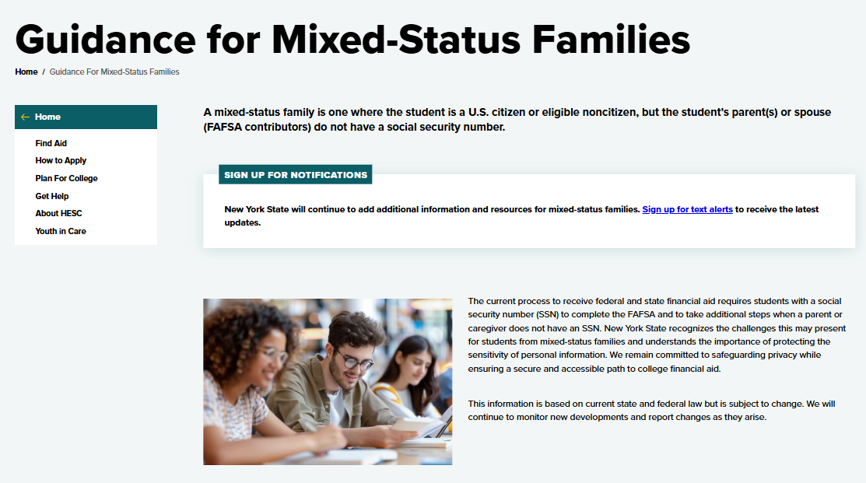
Mixed Status Family Guidance
Key points to consider on FAFSA privacy, Federal and NYS financial aid, and current eligibility requirements
Steps students can take now to gain more information and see what opportunities are available to them.
Guidance for Mixed-Status Families | HESC

Slide 5
  FAFSA Completion Initiative Access

Slide 6
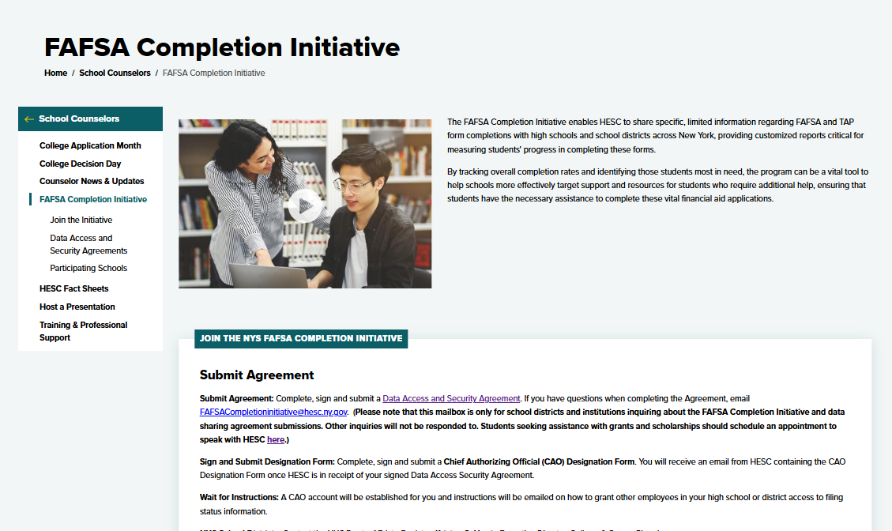

FAFSA Completion Initiative Important Information
FAFSA Completion Initiative webpage
Full list of participating schools
Data Access and Security Agreements
NYC Department of Education Contact information for NYC public schools.
Access reports

Slide 7
FAFSA Completion Initiative Process
Data Access Security Agreement
Chief Authorizing Official Designation
Establish
User Accounts
Run Reports
  Signed by School District or School and submitted to HESC
  Completed to designate CAO and submitted to HESC
  Users from the School District or School establish their user accounts
  Run reports to get data on student financial aid progress.

Slide 8
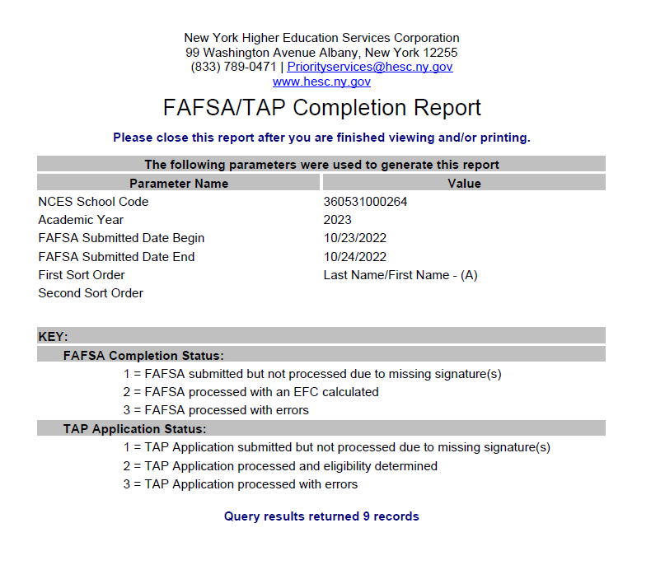
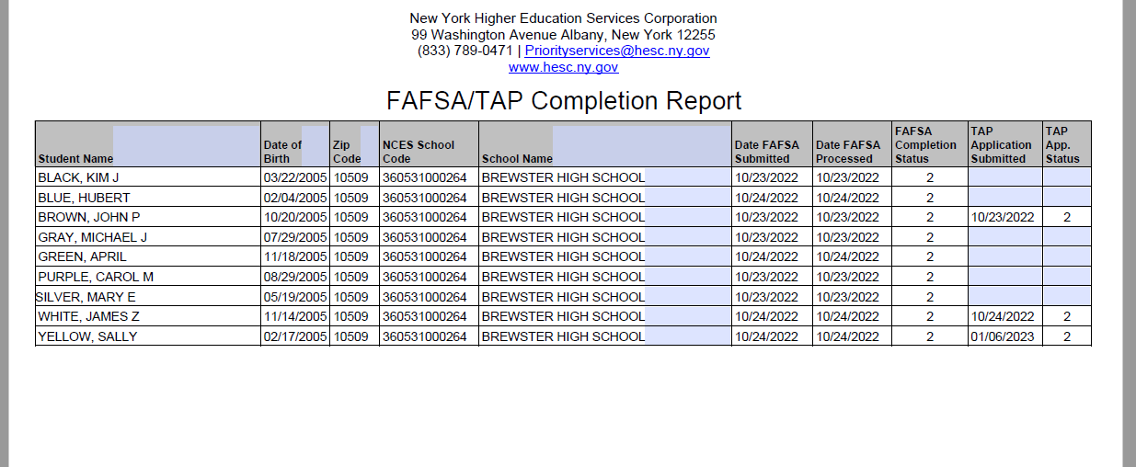
FAFSA Completion Initiative Data
Submission dates for the TAP and FAFSA
Date the FAFSA and TAP were processed
Application processing status.

Slide 9



Three Ways to Help Students
Meetings
Drop-ins
FAFSA Events
1 on 1 meetings to help them complete the FAFSA/TAP
Help them schedule an appointment or attend weekly drop in events
Have them attend a FAFSA/TAP Completion Event
hesc.ny.gov/events

Slide 10
FAFSA Ready Training

Slide 11
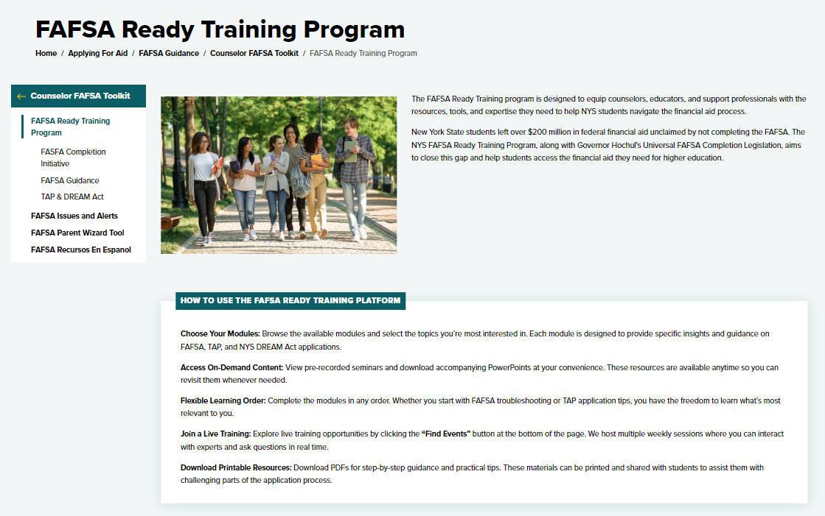
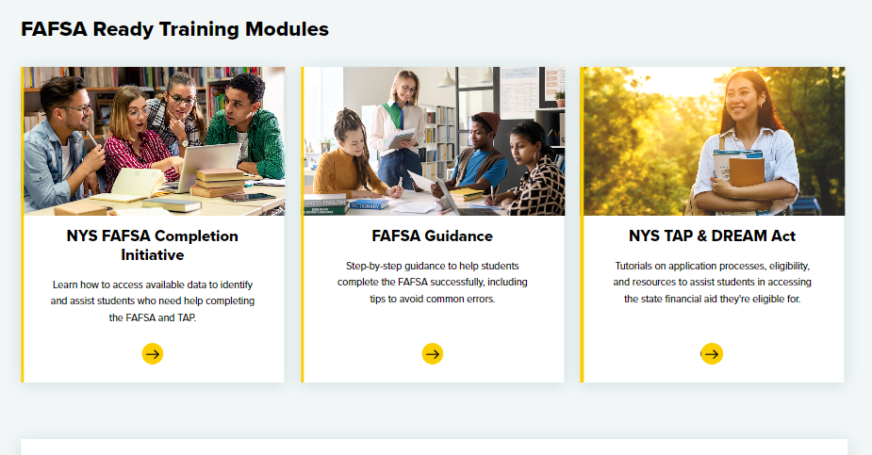
FAFSA Ready Training
Brand new program
Training and resources for counselors, community partners, and financial aid professionals.
Counselors can participate anytime, anywhere.
FAFSA Ready Training Program | HESC

Slide 12
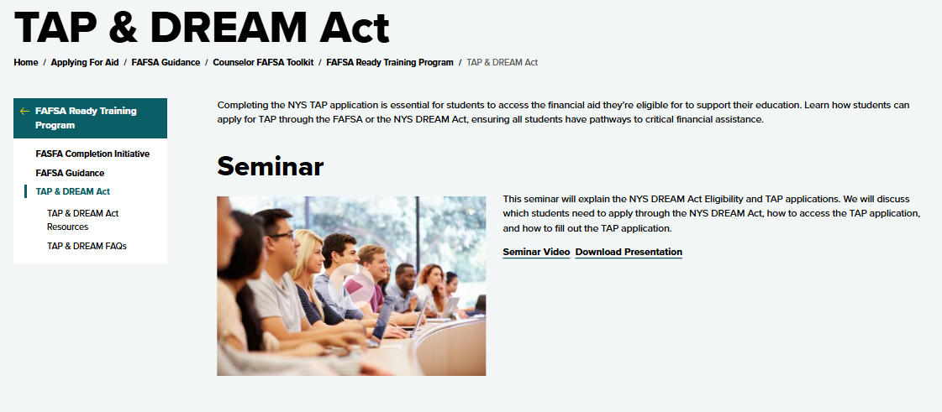
FAFSA Ready Training – Training Seminars
Sign up for a live training or view the latest recording.
Training is offered on a rotation schedule.
Training is updated with the latest information from FAFSA and TAP.
Training presentations are available for download.

Slide 13
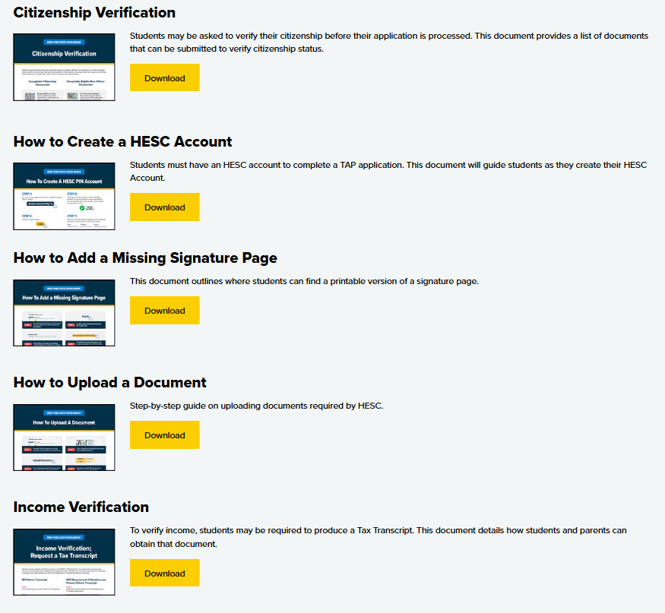
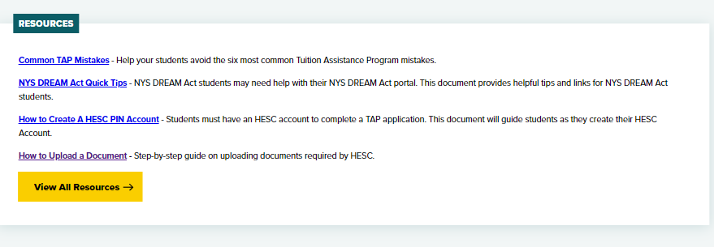
FAFSA Ready Training - Resources
Growing list of downloadable resources
Some resources are available in Spanish. More are on the way.

Slide 14
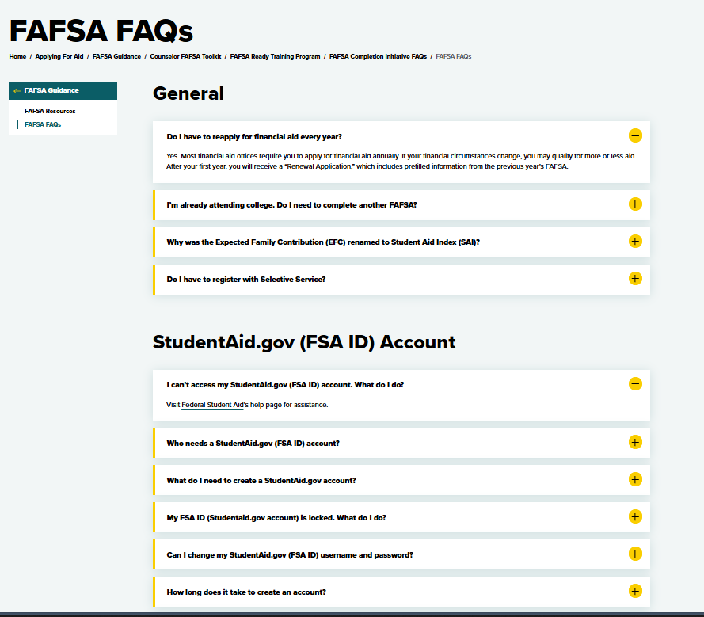
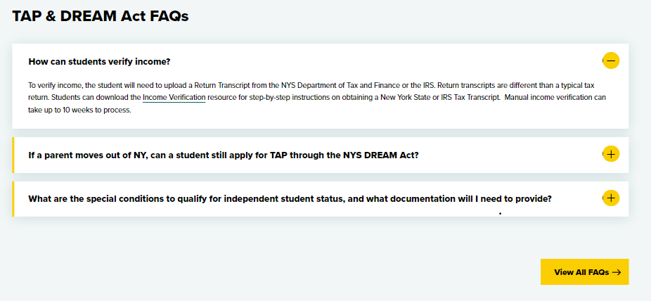
FAFSA Ready Training - FAQs
Sign up for a live training or view the latest recording. Trainings are updated with the latest information
View and print downloadable resources that can help counselors and students.
Growing video library of walkthroughs and how-to videos.
Cumulative list of FAQs

Slide 15
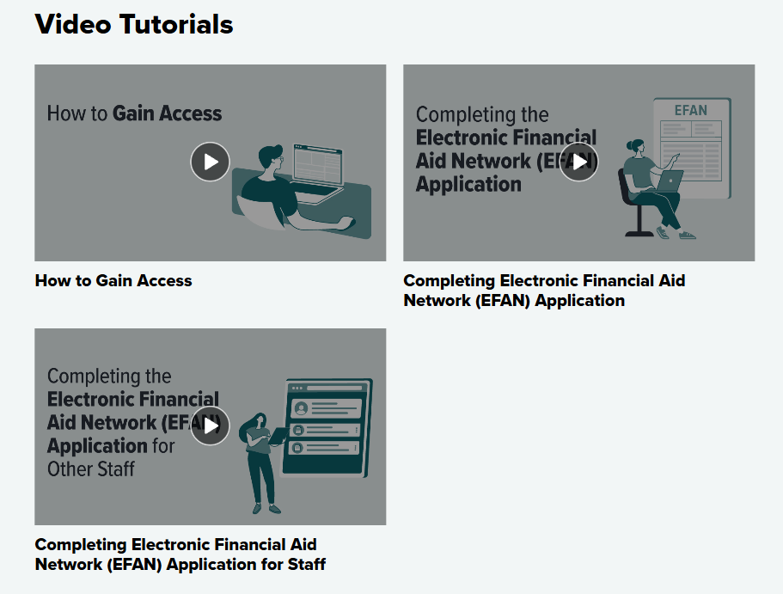
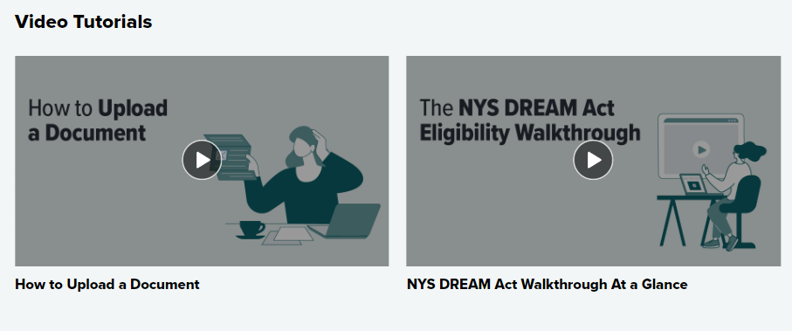
FAFSA Ready Training – Video Walkthroughs
Walkthrough videos on TAP, DREAM ACT, FAFSA, and FAFSA Completion Initiative
More videos on the way!

Slide 16
  TAP Processing Reminders

Slide 17
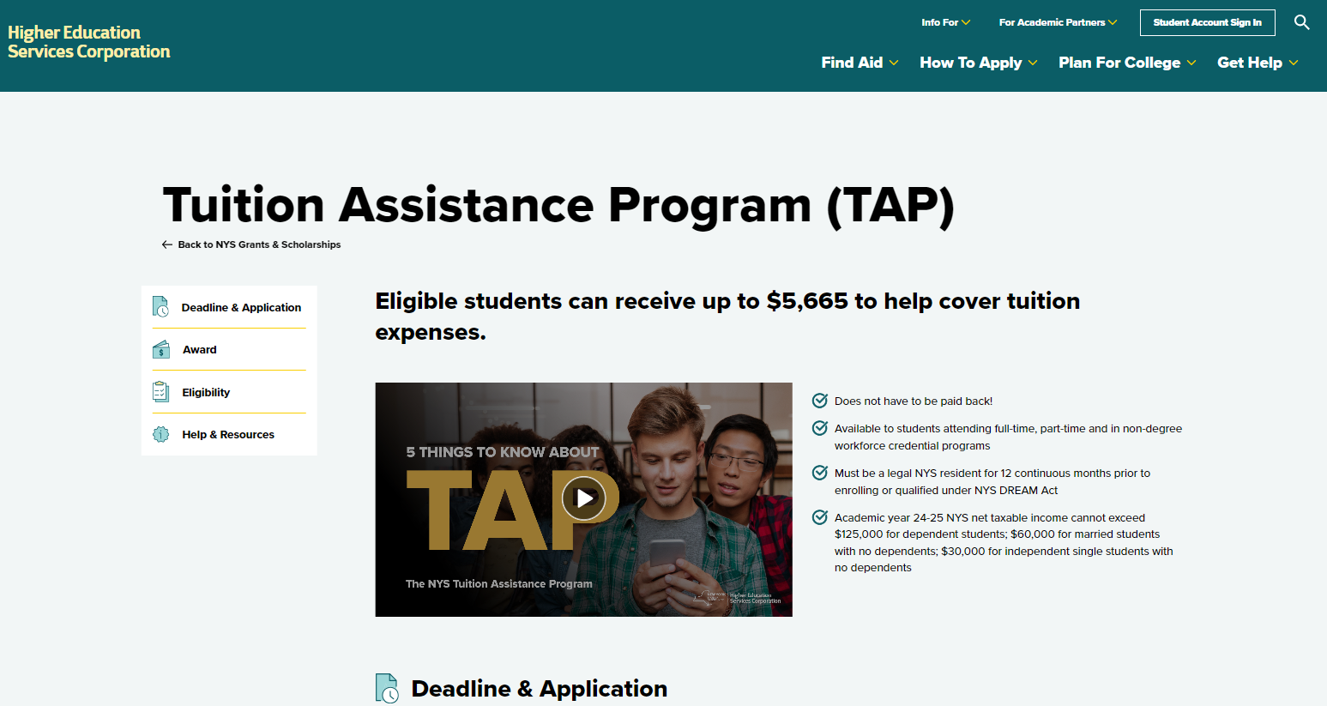
2025-26 TAP Application
2025-26 TAP, DREAM Act TAP applications opened December 1st, 2024
  Application deadline: June 30th, 2026

Slide 18
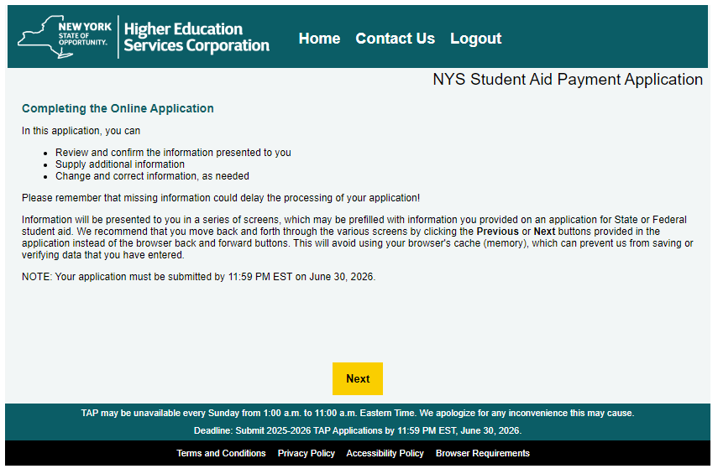
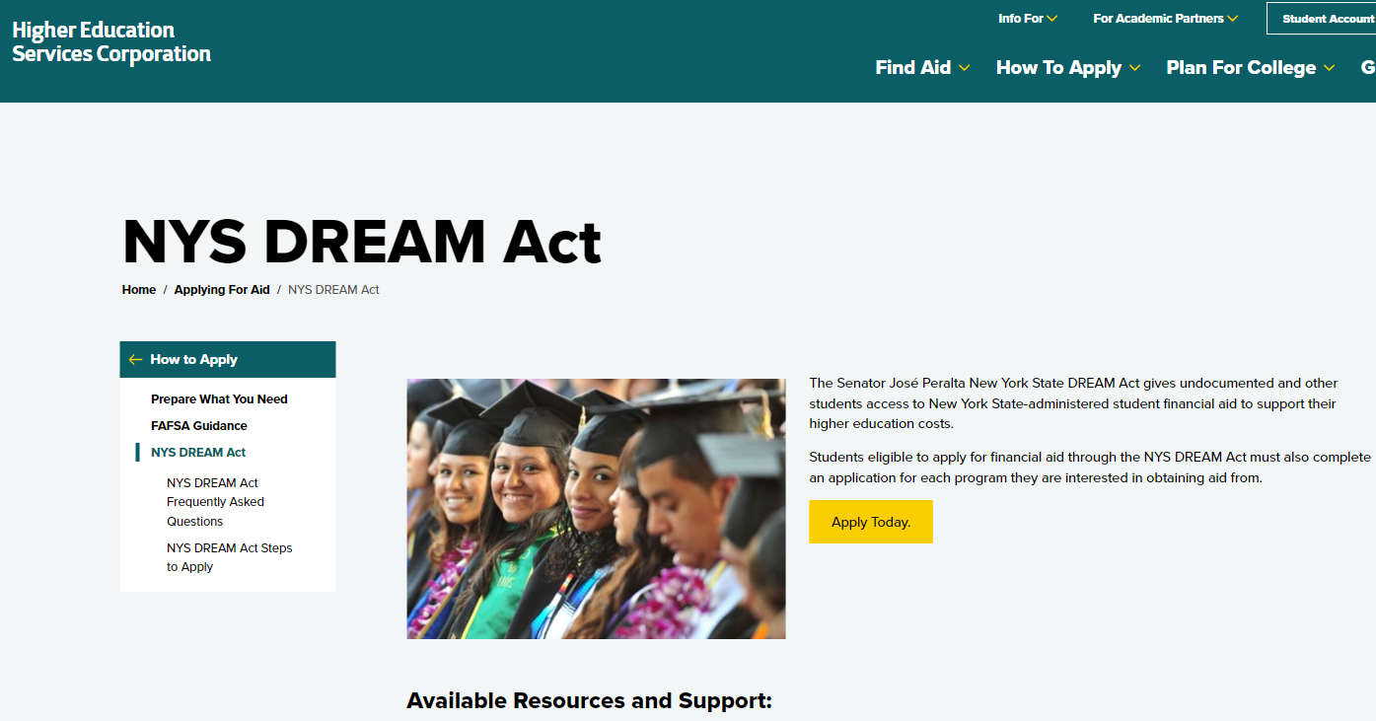

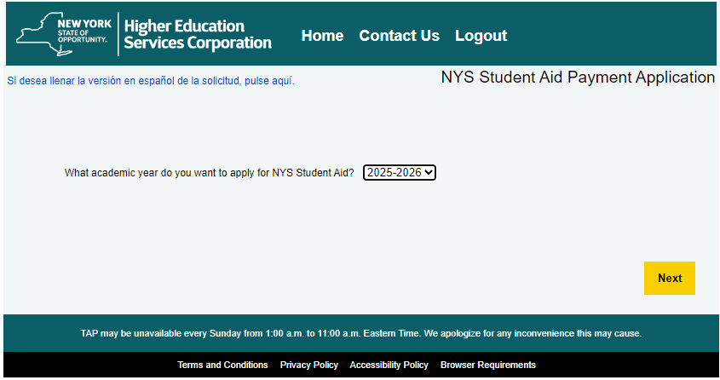
Two Pathways to Apply for TAP
“Traditional” TAP Application
NYS DREAM Act Application

Slide 19
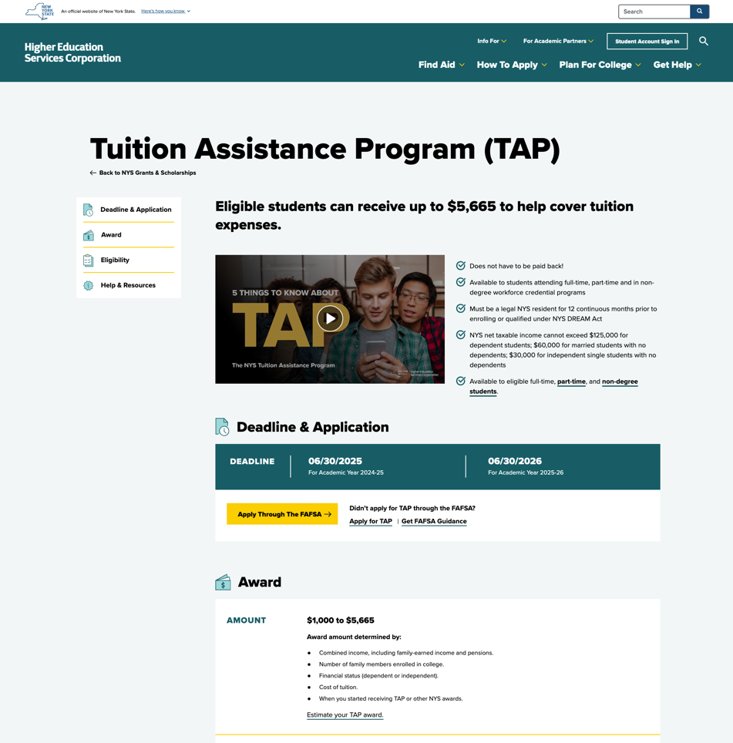
Applying for TAP without FAFSA Link
If a student completes the FAFSA form before their contributor the direct link to TAP will not populate.
Applicants can apply for TAP anytime at hesc.ny.gov
Tuition Assistance Program (TAP) | HESC

Slide 20
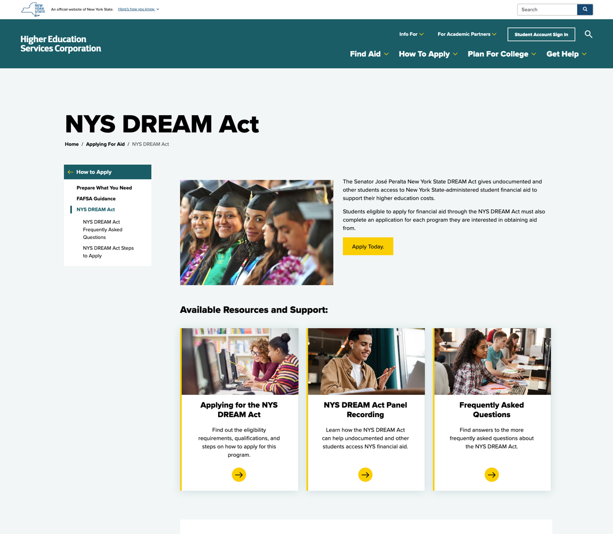
NYS DREAM Act Pathway
For students who do not meet citizenship eligibility for federal aid, such as undocumented and DACA students
Students must meet NYS DREAM Act eligibility criteria
  Graduated from a NYS high school after attending two or more years
  NYS high school equivalency diploma
  Qualified for in-State tuition at SUNY or CUNY
NYS DREAM Act | HESC

Slide 21
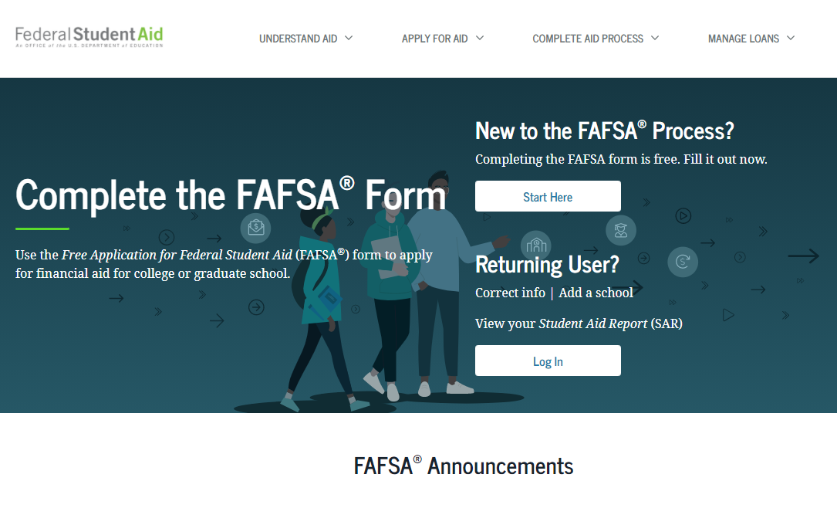
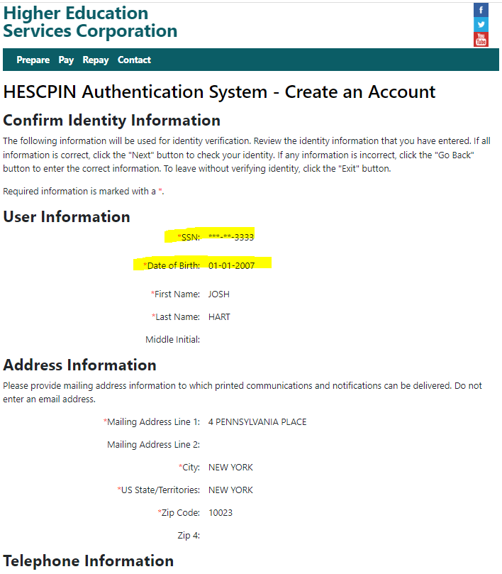
Important Identity Matching
When creating their HESCPIN account, applicants must be sure the identifying information must match their FAFSA.
  Students should create/use their own account to apply (cannot apply using a parent’s account)
  Student SSN, DOB must match exactly to what they used when filing their FAFSA application
TAP applications submitted using HESC accounts that do not match FAFSA identity will not be processed.

Slide 22
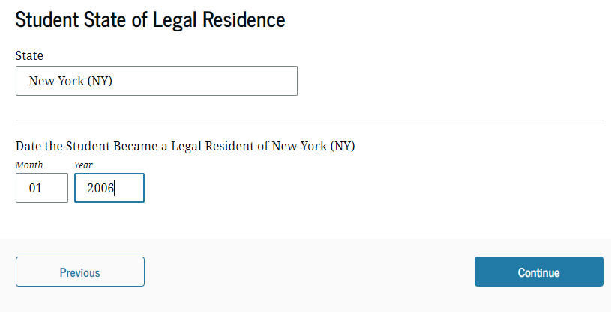
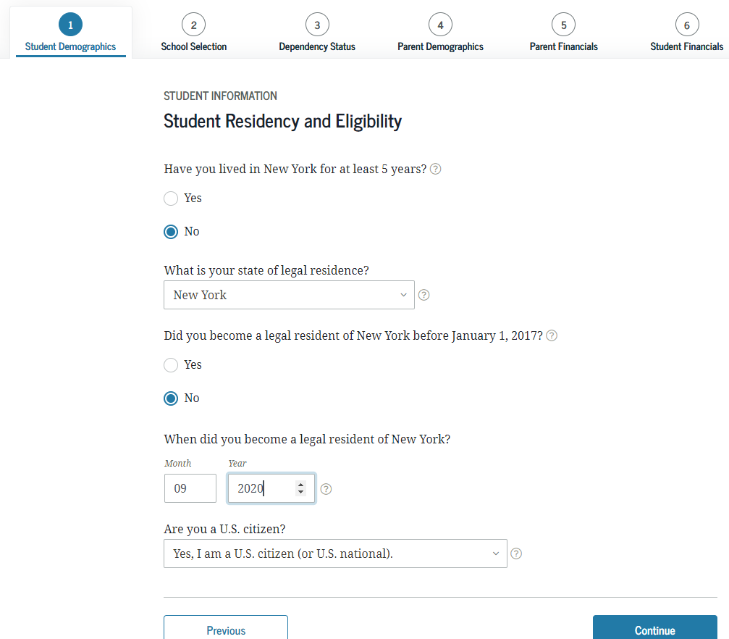

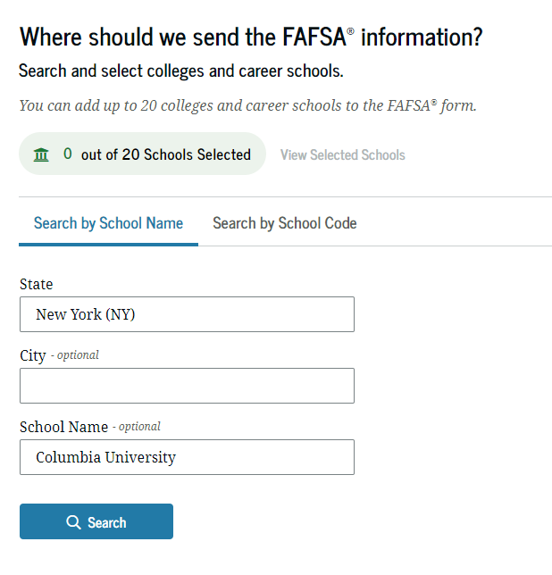
Indicate NYS Residence
Students must be sure to list New York for the “State of Residence” question on FAFSA and list at least one eligible college located in New York State for the TAP application to be made available to them.
Notes:
Students who indicate they are a NYS resident in the FAFSA’s Student Demographics Information page, and….

Slide 23
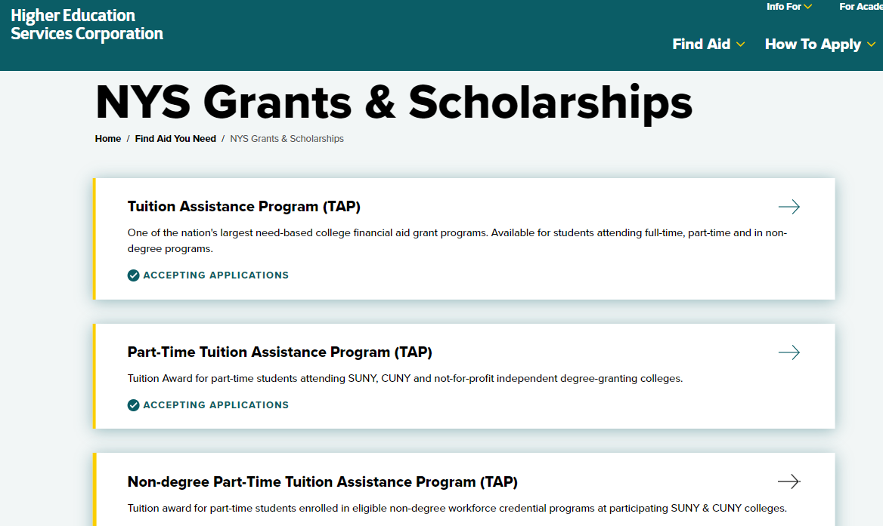

Applying for NYS Scholarships and Incentives
Scholarship programs, including the Excelsior Scholarship, Enhanced Tuition Award and STEM Incentive, require a supplemental application to be filed by first time applicants on HESC website
DREAM Act applicants will be referred to their NYS DREAM Act application to add the scholarship application

Slide 24
THANK YOU!
hesc.ny.gov

