Slide 1
National Emergency
CARES Act - Student Loan Relief

Slide 2
Department of Education
CARES Act signed into law on March 27, 2020
Provides broad relief for student loan borrowers whose loans are owned by the U.S. Department of Education.
  0% interest rate
    Effective from March 13, 2020 through September 30, 2020
  Administrative Forbearance due to National Emergency
    Retroactively applied to begin on March 13, 2020 – the day a National Emergency was declared.
    Granted automatically by the loan servicer for six months.
      Students do NOT need to contact their servicer to request
    The forbearance end date is September 30, 2020.

Slide 3
Federal Loans Eligible for 0% interest rate
There are three types of federal student loans that the 0% interest rate will be applied to from March 13th through September 30th, 2020:
  Direct Loans – both defaulted and non-defaulted loans (including Parent PLUS loans).
  DOE Owned – Federal Family Education Loan (FFEL) – program loans that are owned by the Department of Education and this includes both the defaulted and non-defaulted as well. Some FFEL program loans are owned by commercial lenders and are not eligible for the 0% interest rate.
  Federal Perkins Loans – owned by the Department of Education. Federal Perkins Loans that are owned by institutions or schools are not eligible for the 0% interest rate.
Edfinancial services Direct Loans and commercially-held FFEL loans.

Slide 4
Borrower Relief by Federal Loan Status
In-School
  0% Interest on Federal Subsidized, Unsubsidized & PLUS
In-Grace
  0% Interest on Federal Subsidized, Unsubsidized & PLUS
Repayment
  0% Interest on Federal Subsidized, Unsubsidized & PLUS
  Administrative Forbearance applied to all loans retroactively to March 13th.
  All required payment suspended until September 30, 2020

Slide 5
Borrower Relief by Federal Loan Status
Delinquency
  0% Interest on Federal Subsidized, Unsubsidized & PLUS
  Administrative Forbearance applied to all loans retroactive to March 13th.
  Brings all delinquent borrowers to a “Current Status”.
  All required payments suspended until September 30, 2020.

Slide 6
Borrower Relief by Federal Loan Status
Default – On March 25, 2020, ED announced:
  0% Interest on Federal Subsidized, Unsubsidized & PLUS.
  Federal tax refunds will not be withheld on or after March 13, 2020 and before Sept. 30, 2020.
  Social Security payment that was taken will be returned to the defaulted borrower if the payment was in the process of being withheld—on or after March 13, 2020, and before Sept. 30, 2020.
  Administrative Wage Garnishment (AWG) suspended.
    HR departments will receive a letter from ED instructing them to stop borrowers wage garnishment.
    If ED receives funds from a garnishment between March 13, 2020, and Sept. 30, 2020, they will refund garnished wages.

Slide 7
Borrower Relief by Federal Loan Status
Default – On March 25, 2020, ED announced (continued):
  Department-contracted private collection agencies stopped making collection calls and sending letters or billing statements.
  Defaulted loans owned by ED will not accrue interest from March 13, 2020, through Sept. 30, 2020. This includes:
    Direct Loans
      and
    FFEL Program loans owned by ED

Slide 8
Borrower Relief by Federal Loan Status
Rehabilitation Loans
  0% Interest on Federal Subsidized, Unsubsidized & PLUS.
  Suspended payments during the administrative forbearance count toward rehabilitation.

Slide 9

Impact of National Emergency Forbearance
Good news for your students and institution.
  Brings all delinquent students to a current status.
  FY2017 cohort Appeals extended until June 30, 2020.
  Prevents additional defaults for the FY2018 cohort.

Slide 10
Impact of National Emergency Forbearance
Borrower communication during this time of uncertainty is critical.
Focus on two primary groups of borrowers:
  Students entering grace period
  Students in the FY2019 and FY2020 cohort
    Repayment cycle suspended or delayed
    May be unprepared for repayment once National Emergency is over
Future student impact
  Economic conditions may increase enrollment and borrowing rates.
  Must be prepared to repay the student loan debt that is incurred.

Slide 11

Historical Perspective
Many colleges saw spikes in enrollment following the last recession in 2008.
Colleges also experienced increased delinquency and default rates for students who were unprepared for repayment.
  FY2009, FY2010, FY2011 cohort default rates

Slide 12
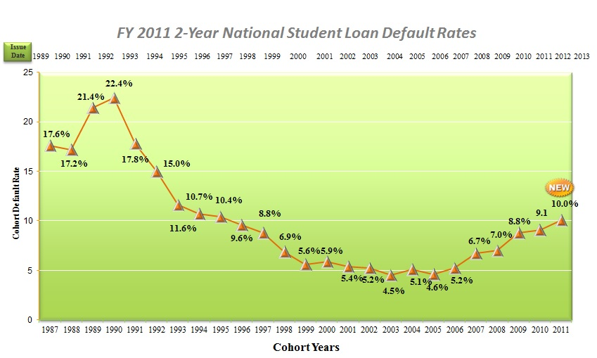
Historical Perspective – 2 Year Default Rates
History teaches us Default Rates spike considerably after a recession!

Slide 13
Edamerica Recommended Strategy for your Borrowers
Get Ahead of the Curve
No loans are in a delinquency status as of September 30, 2020
Educate borrowers entering or reentering repayment
Deploy Proactive Support Strategies
Be prepared for what happens after National Emergency Forbearance
Take steps to prevent future spikes in delinquency and default

Slide 14
Edamerica Strategy for your Borrowers
Recommendation
Refocus current default prevention strategy for your college to preventative action:
  Early Intervention – Grace borrower counseling, educating borrowers on the obligation to repay and proper repayment plan best for the individual.

Slide 15

Edamerica Strategy (continued)
Goal
Position borrowers for success
Take counter measures to combat potential increases in delinquency before the student enters or re-enters repayment
Prevent future spike in default rates

Slide 16
Administrative Forbearance – Q&A

Slide 17

Administrative Forbearance – Q&A
Question 1: If I made a payment after the President signed the CARES Act on March 27, 2020, can I receive a refund?
Yes! The CARES Act is providing an administrative forbearance from March 13, 2020 through September 30, 2020. Any payment made during this forbearance period is eligible for a refund.
Borrowers can contact their loan servicer to request a refund of any payment made between March 13, 2020 and September 30, 2020.

Slide 18
Administrative Forbearance – Q&A
Question 2: What if I want to continue making a partial payment while my loan is in forbearance, can I do that?
Borrowers can absolutely continue making payments on their loan! The administrative forbearance has been applied from March 13, 2020 through September 30, 2020, so no payments are required during this time. Borrowers can, however, choose to make payments in any amount at any time.
Keep in mind that a 0% interest benefit has been applied from March 13, 2020 through September 30, 2020. Once the interest that had accrued prior to March 13, 2020 has been satisfied, any additional payments made will be applied directly toward the principal balance.

Slide 19
Administrative Forbearance – Q&A
Question 3: I’m currently on an IDR plan. I’m now unemployed and don’t know when my income will return to the same level. Should I apply for UED now?
Borrowers are automatically placed in an administrative forbearance, so no payments are due from March 13, 2020, through September 30, 2020.
Loans will also receive a 0% interest rate benefit for this same time frame so applying for an Unemployment Deferment will not result in less interest accruing on the account.
There is a maximum time of allowance on the Unemployment Deferment, so we recommend saving that time in case it’s needed in the future.
One option borrowers may want to consider is having their Income-Driven Repayment (IDR) plan recalculated if their income has changed. This way, when the forbearance ends in September, the new IDR payment will be based on their current income situation.

Slide 20

Administrative Forbearance – Q&A
Question 4: How will I know when I have to start making payments again?
The 0% interest and the current administrative forbearance are set to expire on September 30, 2020.
This means borrowers will begin “Repayment Status” in October.
Borrowers will be contacted ahead of time, no later than August, to remind them of the forbearance end date as well as to notify them of available repayment options.
Borrowers will also be sent a billing statement notifying them
of their upcoming payment due.

Slide 21
Administrative Forbearance – Q&A
Question 5: What will happen to my regular auto-debit payment if I do nothing?
Auto-debit payments are suspended during the administrative forbearance which is in effect from March 13, 2020, until September 30, 2020. Once the forbearance and 0% interest benefit ends on September 30, 2020, and the loan enters repayment status, the auto-debit will automatically resume.
Borrowers have the option to remain in the administrative forbearance and make manual payments through their online account during the forbearance period.
Borrowers can contact their servicer at any time to opt out of the forbearance prior to September 30, 2020, and their auto-debit payments will resume.

Slide 22
Administrative Forbearance – Q&A
Question 6: Can my suspended payments count toward Public Service Loan Forgiveness (PSLF)?
Yes. Borrowers will not be penalized by remaining in the administrative forbearance. The time in forbearance, from March 13th through September 30th, will count as borrowers were making full, on-time monthly payments.
If borrowers have a Direct Loan and work full-time for a qualifying employer during the suspension, then they will receive credit toward PSLF during the period of suspension.*
*Please note the PSLF servicer will require employment certification for this time frame in order to receive credit towards PSLF.

Slide 23
Administrative Forbearance – Q&A
Question 7: Interest is being temporarily set at 0% on federal student loans. Which loans does the 0% rate apply to?
There are three types of federal student loans that the 0% interest rate will be applied to from March 13th through September 30th, 2020:
  Direct Loans – both defaulted and non-defaulted loans (including Parent PLUS loans).
  DOE Owned – Federal Family Education Loan (FFEL) – program loans that are owned by the Department of Education and this includes both the defaulted and non-defaulted as well. Some FFEL program loans are owned by commercial lenders and are not eligible for the 0% interest rate.
  Federal Perkins Loans – owned by the Department of Education. Federal Perkins Loans that are owned by institutions or schools are not eligible for the 0% interest rate.
Edfinancial services Direct Loans and commercially-held FFEL loans.

Slide 24
Administrative Forbearance – Q&A
Question 8: How can I take advantage of this 0% interest period if I have Federal Family Education Loan (FFEL) Program and Federal Perkins loans not owned by ED?
Borrowers can speak to their lender or school to see if those benefits are being provided.
Another option is to consolidate the borrowers FFEL Program or Federal Perkins loans, not owned by the Department of Education, into a Direct Consolidation Loan. By doing this, it would make the borrower eligible for the 0% interest.
  Borrowers will need to complete this during the time the interest rate is 0% or your interest rate may be higher than you are currently paying.
One other thing to note when making this decision to consolidate is that any outstanding interest will be capitalized upon consolidation.

Slide 25
Administrative Forbearance – Q&A
Question 9: Are private student loans eligible for the 0% interest benefit?
No. The Department of Education does not have legal authority over private student loans, and private loans are not covered by the CARES Act.
We would encourage borrowers to reach out to their private loan lender to see if they are offering any benefits during this time.

Slide 26
Administrative Forbearance – Q&A
Question 10: If I’m trying to rehabilitate my defaulted student loan, will my suspended payments count toward my rehabilitation?
  Yes.

Slide 27
For more information, please contact:
Elena Lubimtsev
Senior Vice President
elubimtsev@edamerica.net
(865) 712-8268
Thomas Dalton
Director of Sales & Marketing, Northeast
tdalton@edamerica.net
(865) 202-5666

